Slide 1
Professional Issues in Software Engineering
CS4818
Dr. Joe Griffin
joe.griffin@ul.ie

Slide 2
What is Professional Issues?

Slide 3

Definition
The ethical, legal and social consequences of the design, implementation and use of computer and information systems

Slide 4
Why should hard-nosed (potential) IT professionals be concerned with a wimpy subject like Professional Issues?

Slide 5
A true story…
Amy Boyer
RIP
Murdered by the Internet ?
Notes:
October 1999
20 yr old Amy was murdered by cyber stalker Liam Youens.
He gathered personal information on Amy using standard search tools. He found out where she lived. Where she worked. Her car registration and type.
He built 2 web sites dedicated to Amy. On one he posted her personal information and her photo. On the 2nd he described in explicit detail how he intended to murder Amy.
The case raises a number of ethical and social issues about privacy, personal security, free speech, & censorship, moral responsibility and legal liability.
Was Amy’s right to privacy violated? It was all publicly available information.
Was Youen’s right to sent up a website with this information?
Was it OK for him to publish this information (this was in the US where there is a constitutional right to freedom of speech)
Should the ISPs have allowed him to post this stuff?
Are they legally liable?
What about users who came across the murder website? Have they any moral obligations? Should they have told Amy? Would you? Would you tell me if you knew somebody in your class has copied an assignment?

Slide 6
Some questions
Was Amy Boyer's right to privacy violated?
Was Liam Youens' right to set up websites, without prior consent or knowledge a violation of Amy's rights?
Was Youens protected by the right to free speech even if some material was defamatory?
Should the ISPs have stopped Youens?
Should they be held legally liable?
Should an ISP be liable for contributing to Boyers' murder?
Do ordinary users have a moral responsibility to report those who are threatened or the authorities?

Slide 7
Some ethical issues
ILOVEYOU virus
Denial of service attacks (wikileaks)
Pornography (and what is this anyway?)
Privacy (FB etc)
Freedom of expression
Censorship
Email and spam
Governing the web

Slide 8
Legal issues
Intellectual property
Data protection
Whistleblowing
Computer Misuse Act
Software contracts and liability

Slide 9
Social issues
Computers and work
Digital divide
Access to online information
Impact of computer technology
Artificial intelligence

Slide 10
Module structure
(see Module Details on Moodle for full information)
Lectures
Tutorials
Assessment -
  Group work - Moral dilemma report - 40%
  Exam - 50%
  Contributions – 10%
Moodle - http://moodle.csisdmz.ul.ie

Slide 11
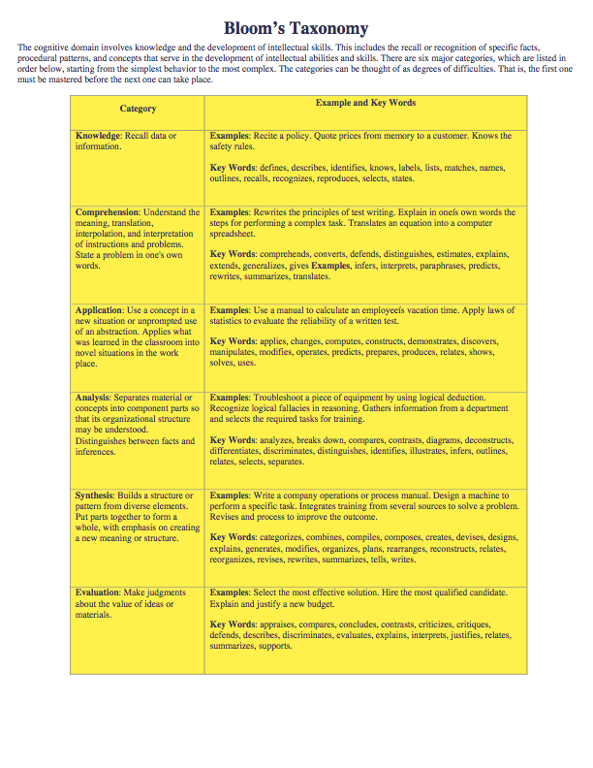

Slide 12

Some reasons for studying PISE
Scientists are different
  Objective
  Quantifying
  ‘Scientific method’
‘Fact-based’ training and education
  Is the world entirely fact-based?
  Is there an answer to every question?
Philosophy and logical/critical thinking skills
Being a professional

Slide 13
Some issues
Email V Spam
Freedom of speech V Slander & Libel
File copying V Stealing (MP3 anybody?)
On-line shopping V Identity theft
Spyware V Customer care
Monitoring V Snooping
Outsourcing V Job losses
Learning V Plagiarism
Democracy V Repression (Google China)

Slide 14
How can we tell the difference between right and wrong?
We all have a sense of right and wrong:
  Things we think we ought to do
  Things we thing we ought not do
How can we make sense of this - in order to:
  Make ethical choices
  Discuss options rationally
  Justify choices to others

Slide 15
These provide no basis for rational discussion or accountability
I am intuitively able to distinguish between right and wrong. But is your intuition the same as that of others?
My religion tells me the difference between right and wrong. But not everybody shares your religion.
If something is against the law then it’s wrong. But different countries can have different laws.
If my family behaves in a certain way then it must be right. Hmmmmm, depends on the family.

Slide 16
Some alternative ways to conduct ethical analysis
Golden rule (Kant)
Treat others as you would like to be treated
  Familiar in many cultures and religions
  Can be accepted as fair by everyone
  Is applicable to people in all situations

Slide 17
Another rational alternative
The Utility Principle (Bentham and others)
The greatest good for the greatest number of people
  Favours actions that create the greatest amount of happiness for the greatest number of people
  Can also be accepted as fair by everyone and applicable to all people in all situations
  Practical difficulty in quantifying ‘happiness’

Slide 18
Difference between these
Golden Rule | Utility Principle
Emphasises the intent underlying action An act is good or bad in and of itself | Emphasises the effects of the action An act is good if it produces good outcomes or consequences

Slide 19
What should Jane do?
Jane is a student who needs a copy of a textbook for an assignment, the library has a single copy which is on loan. The book can be bought for €48 but her friends tell her it is available on a file share website where she can download it for free. But this would violate the author’s copyright. But she cannot afford the cost of buying the new book.

Slide 20
Act utilitariansim: act is such a way as to promote the greatest happiness
Look at individual act:
1 Downloading makes Jane happy but makes author unhappy
2 Buying makes author unhappy but Jane unhappy
So, no resolution.

Slide 21
Rule utilitarianism:formulate a general rule that will promote the greatest happiness.
If everyone used file sharing sites there would be no incentive for authors to write books therefore no more books
This would make lots of people less happy; authors would not be able to make a living; readers would have less books
Therefore RULE = Do not use file sharing sites
Therefore Jane should not use the site.

Slide 22
Golden Rule
Jane should treat others as she would like to be treated herself
Using file share site deprives author of income
If Jane were the author she would not like to be deprived of income
Therefore Jane should not use the file share site.

Slide 23
Some central questions
Who should be accountable when medical software contains bugs that result in the maiming or deaths of several patients?
When an imposter on a computer bulletin board creates significant violations of trust, is his behavior mitigated by the fact that some therapeutic good was also achieved?
When a multimillion-pound software project is behind schedule, should technical staff who doubt its ability to be effectively rescheduled and completed inform the client organisation?

Slide 24
More questions
To what extent are computer scientists morally responsible for anticipating and publicising some of the problems, as well as the social good, that is likely to result from their creations?
Are there any limits to the extent that the managers and owners of private firms can examine the detailed movements of their employees?
To what extent should employees or managers anticipate the possibility of ailments from intensive computer use, such as repetitive strain injuries, and who is most responsible for what kinds of actions?

Slide 25
And more …
Do computers and computer related technology really raise new ethical problems or do they just present old issues in a new form?
Should the Internet be self-governing? What are the advantages and disadvantages?
What political implications do the development of computer technology have in terms of our democratic system.

Slide 26
And more …
Should the principle of freedom of speech be upheld on the Internet? Are there any instances when it should be legally curtailed?
Does it really matter if the computer systems hold inaccurate data of a few individuals?
Discuss the ethics of Supermarkets or Banks seeking customer loyalty with the use of I.T.

